Slide 1
Education through Civic engagement and Mediation
Cre@t1ve Conflict Resolution and Peer-To-Peer School Mediation

Slide 2
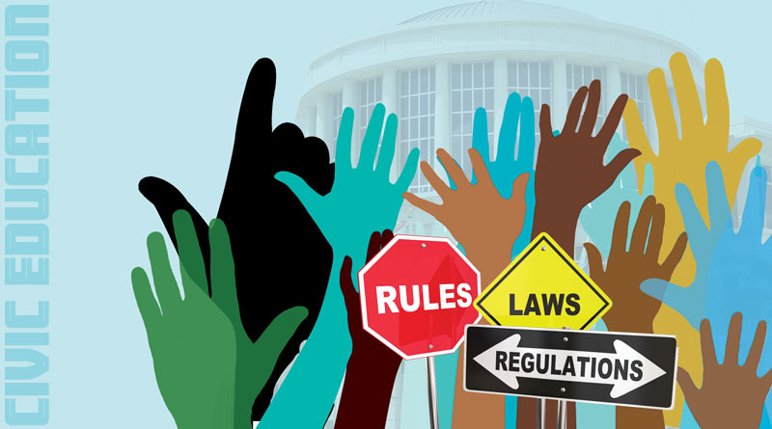
What is civic education?
Civic education is the study of the theoretical, political and practical aspects of citizenship, as well as its rights and duties.

Slide 3
Why is civic education important?
Schools are responsible for civic education and for educating the students. This means that they need to develop educative processes that take into account the social and affective dimension of the classroom, such as improvements in the atmosphere at school and the quality of teacher–student relationships. The most important strategy - mediation as a conflict resolution procedure is required in schools. This also promotes a wide range of emotional, socio-cognitive, and socio-moral skills, and can be influential in the development of effective civic behaviour to improve the community

Slide 4
What is the purpose of civic education and its engagement?
The most important public purpose of schools is to prepare the next generation of active, engaged citizens for our democracy, and therefore, influence the future of communities.

Slide 5
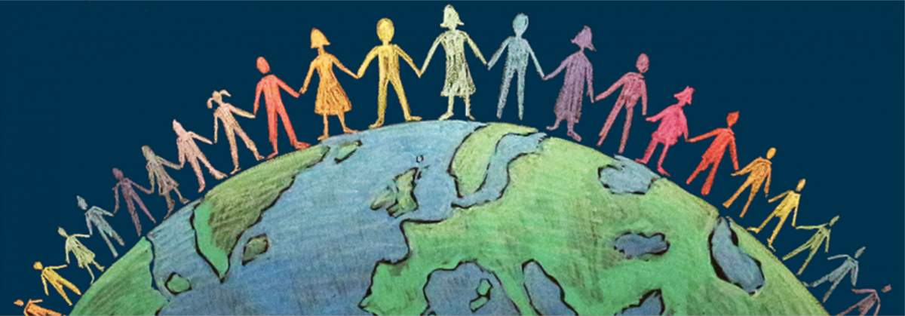
What does civic engagement involve?
Civic engagement involves “working to make a difference in the civic life of one's community and developing the combination of knowledge, skills, values and motivation to make that difference. ... Volunteering, national service, and service-learning are all forms of civic engagement.

Slide 6
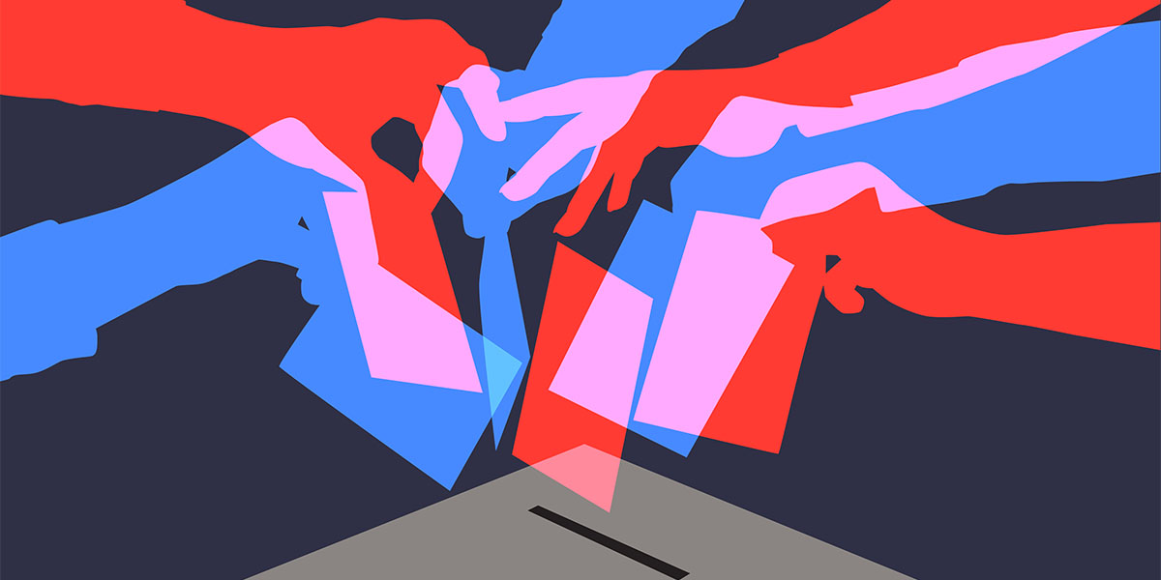
What are some examples of civic engagement?
Examples include voting, volunteering, participating in group activities, and community gardening. Some are individual activities that benefit society (e.g., voting) or group activities that benefit the group members like volunteer organizations.

Slide 7
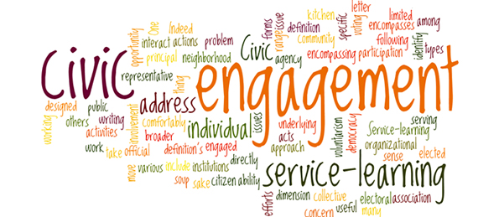
What does civic engagement mean?
Civic engagement or civic participation is any individual or group activity addressing issues of public concern. Civic engagement includes communities working together in both political and non-political actions. The goal of civic engagement is to address public concerns and promote the quality of the community.

Slide 8
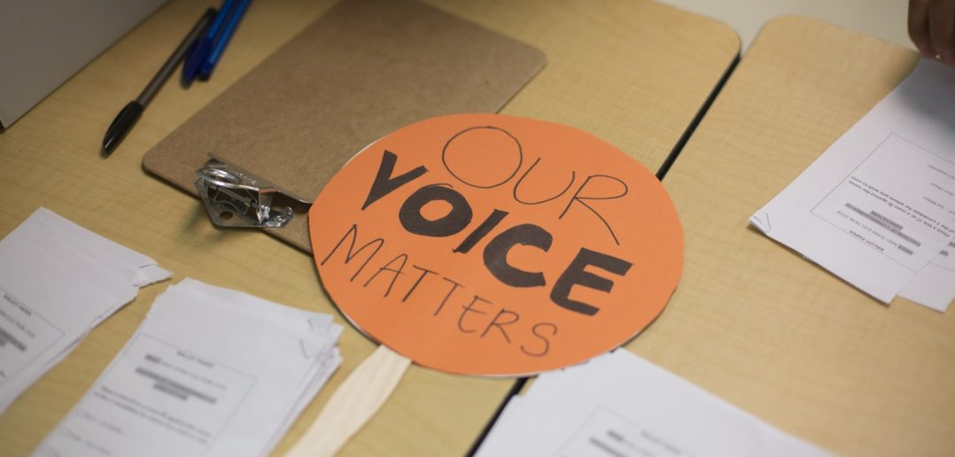
Why is civic engagement important for students?
Students who participate in civic engagement gain interpersonal effectiveness, the ability to collaborate across diverse perspectives, and a sense of self-efficacy for positively impacting individuals, organizations, and communities.

Slide 9
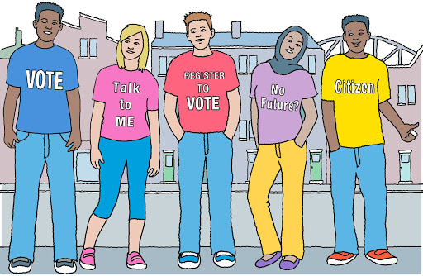
What makes an active citizen?
An active citizen is someone who cares about their community enough to change it. You can become an active citizen and help to make your community a better place in any of the following ways.

Slide 10
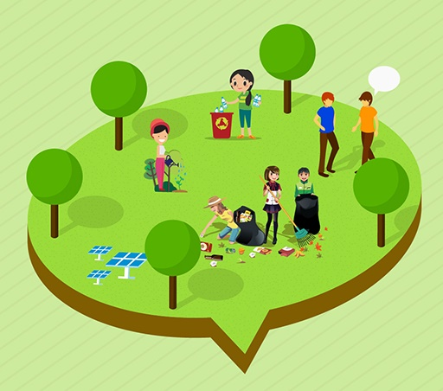
6 Ways to Transform Students into Active Citizens
Be informed
Be engaged
Be mediative
Be present
Show empathy
Be inspired

Slide 11
What are examples of being good citizens in our 6th High School (VILO)?
being respectful of other people and their property
being respectful of school property
following school rules
displaying good character
(responsibility, honesty, good listening, kindness)

Slide 12
Why do we engage students in the Community Beyond schools?
Students who spend time volunteering during school time become more convinced that individuals can change society, feel more committed to effecting social change, and develop stronger leadership skills.

Slide 13
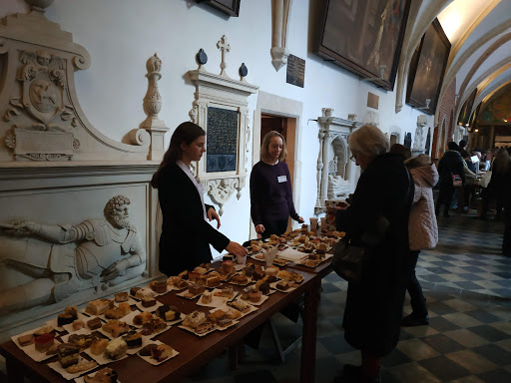
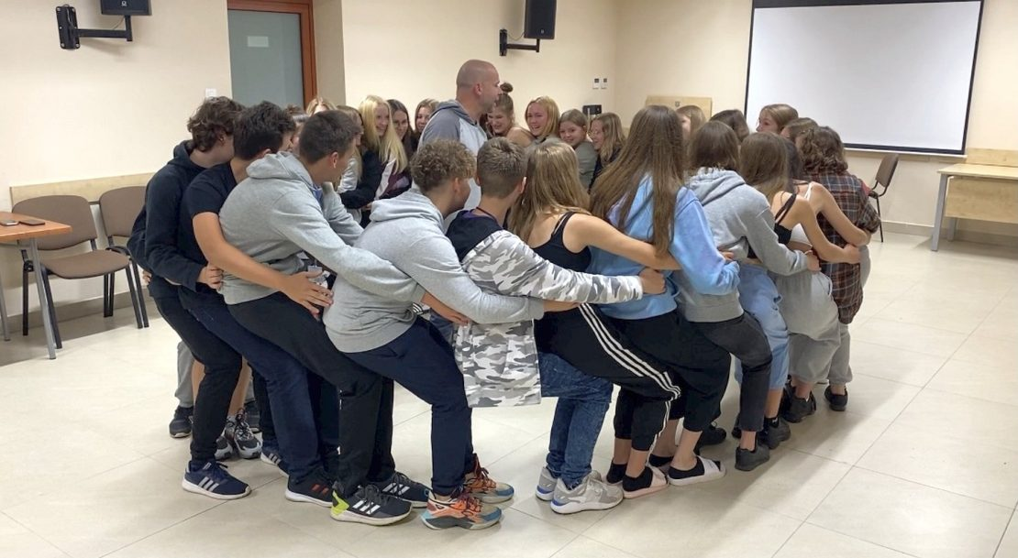
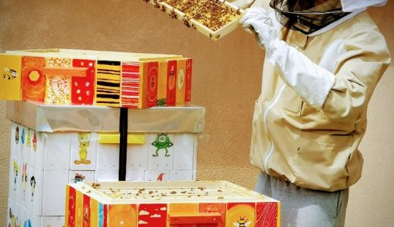
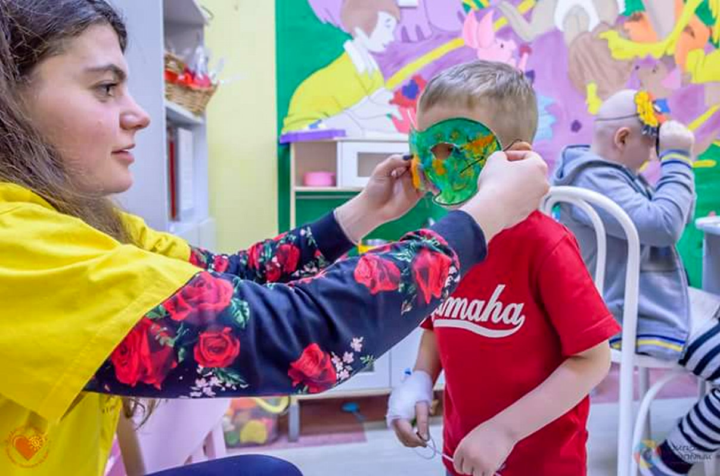
What are our school activities in terms of civic engagement?
Organizing school events to support an individual/group with some financial help (Christmas fairs, money collecting)
Volunteering (Eleos/Caritas actions: a Christmas parcel for the needy)
Being involved into community cleanup actions: Green city, Clean Forrests etc.
Active involvement in Erasmus+ Club which means good communication between students through mediative conflict resolution
Participation in Erasmus+ project which means socialization and cooperation on school and international levels
Organizing visits to Cancer and Leukaemia Ward in Bialystok’s hospital to teach and support ill children by our VILO students and teachers

Slide 14
Thank you for your involvement☺
Prepared by VILO students and a coordinating teacher

